Slide 1
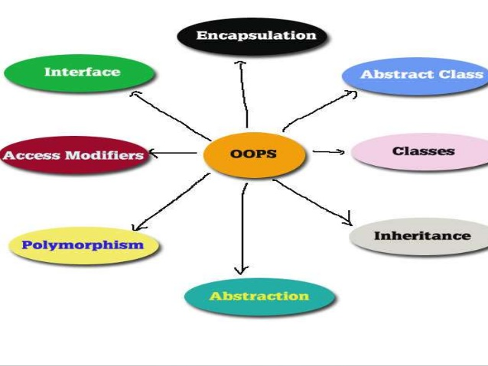
Object Oriented Programming & Design
Session – 2: 30-Sep-2018
Notes:
NOTE:
To change the image on this slide, select the picture and delete it. Then click the Pictures icon in the placeholder to insert your own image.

Slide 2

Agenda
My First Java Program
  Variables
  Methods
Constructors Explained
This Keyword
Overloading
Mutable vs Immutable
Passing Objects as Parameters

Slide 3
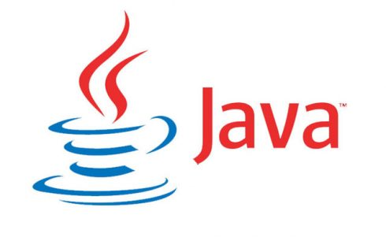
My First dose of Java
Not your regular cuppa, I daresay mind the beans for now!!

Slide 4
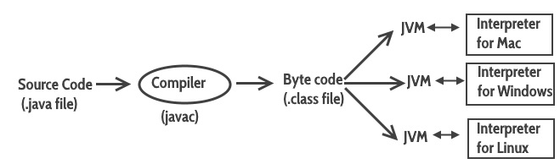
Java Virtual Machine (JVM)
Java is a high level programming language. Meaning cannot be run on any machine directly.
First, it needs to be translated into that particular machine language. The javac compiler does this thing, it takes java program (.java file containing source code) and translates it into machine code (referred as byte code or .class file).
Java Virtual Machine (JVM) is a virtual machine that resides in the real machine (your computer) and the machine language for JVM is byte code.
This makes it easier for compiler as it has to generate byte code for JVM rather than different machine code for each type of machine. JVM executes the byte code generated by compiler and produce output.
JVM is the one that makes java platform independent.

Slide 5
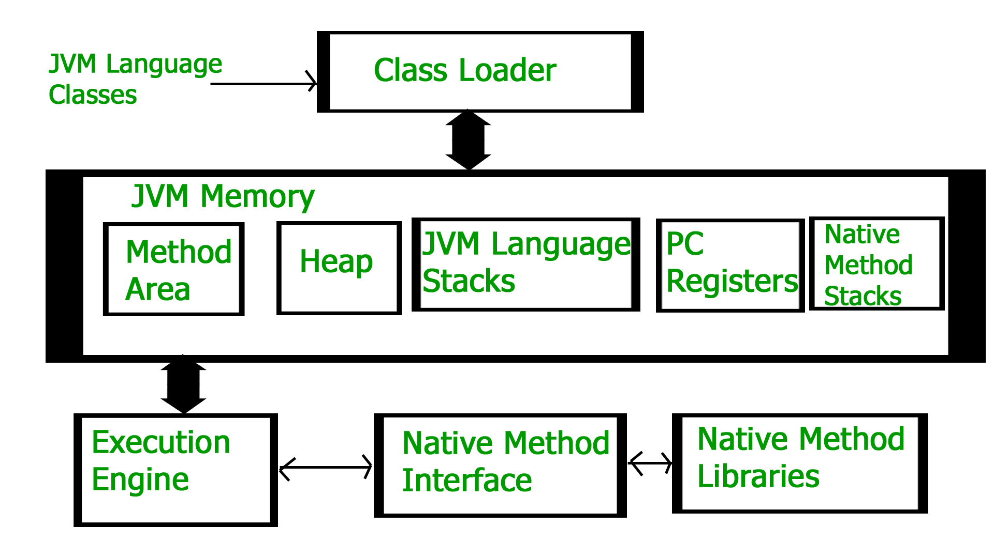
Java Virtual Machine (JVM) - Architecture

Slide 6
Java Virtual Machine (JVM)
Class Loader: The class loader reads the .class file and save the byte code in the method area.
Method Area: There is only one method area in a JVM which is shared among all the classes. This holds the class level information of each .class file.
Heap: Heap is a part of JVM memory where objects are allocated. JVM creates a Class object for each .class file.
Stack: Stack is also a part of JVM memory but unlike Heap, it is used for storing temporary variables.
PC Registers: This keeps the track of which instruction has been executed and which one is going to be executed. Since instructions are executed by threads, each thread has a separate PC register.
Native Method stack: A native method can access the runtime data areas of the virtual machine.
Native Method interface: It enables java code to call or be called by native applications. Native applications are programs that are specific to the hardware and OS of a system.
Garbage collection: A class instance is explicitly created by the java code and after use it is automatically destroyed by garbage collection for memory management.

Slide 7
Let’s get Started : The main () conundrum
  main ()
  main method in Java is a standard method which is used by JVM to start execution of any Java program.
  main method is referred as entry point of Java application which is true in case of core java application but in case of container managed environment like Servlet, EJB or MIDlet this is not true as these Java programs have there own life-cycle methods like init(), service() or destory() for Servlet's which is used by container.
  main method in Java is run by main thread which is a non daemon thread and Java program runs until main method finishes or any other user thread is running.
  When we start JVM by running java command we also provide name of class which contains main method, which is later invoked by JVM to start Java program execution.

Slide 8
Let’s get Started : The main () conundrum
  main ()
  Since the main method is static Java virtual Machine can call it without creating any instance of a class which contains the main method.
  If main method were not declared static than JVM has to create instance of main Class and since constructor can be overloaded and can have arguments there would not be any certain and consistent way for JVM to find main method in Java
  Anything which is declared in class in Java comes under reference type and requires object to be created before using them but static method and static data are loaded into separate memory inside JVM called context which is created when a class is loaded. If main method is static than it will be loaded in JVM context and are available to execution

Slide 9
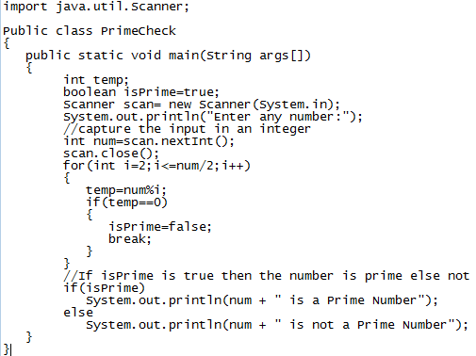
Java Program Introspection

Slide 10
Java Program Introspection
Public class PrimeCheck
  This is the first line of our java program.
  Every java application must have at least one class definition that consists of class keyword followed by class name.
  When I say keyword, it means that it should not be changed, we should use it as it is. However the class name can be anything (Please don’t get cute with class names, stick to Nouns for readability)
  I have made the class public by using public access modifier, we will cover access modifier in a separate session, all you need to know now that a java file can have any number of classes but it can have only one public class and the file name should be same as public class name.

Slide 11
Java Program Introspection
public static void main(String[] args) {
This is our next line in the program, lets break it down to understand it:
public: This makes the main method public that means that we can call the method from outside the class.
static: We do not need to create object for static methods to run. They can run itself.
void: It does not return anything.
main: It is the method name. This is the entry point method from which the JVM can run your program.
(String[] args): Used for command line arguments that are passed as strings. We will cover that in a separate post.

Slide 12
Variables
A variable is a name which is associated with a value that can be changed. For example when I write int temp=10; here variable name is temp which is associated with value 10, int is a data type that represents that this variable can hold integer values.
Declaring Variables :To declare a variable follow this syntax:
data_type variable_name = value;
char ch = 'A'; int number = 100;
char ch; int number; ...
ch = 'A'; number = 100;
1) Variables naming cannot contain white spaces, for example: int num ber = 100; is invalid because the variable name has space in it.
2) Variable name can begin with special characters such as $ and _
3) As per the java coding standards the variable name should begin with a lower case letter, for example int number; For lengthy variables names that has more than one words do it like this: int smallNumber; int bigNumber; (start the second word with capital letter).
4) Variable names are case sensitive in Java.
There are three types of variables in Java.
1) Local variable 2) Static (or class) variable 3) Instance variable

Slide 13
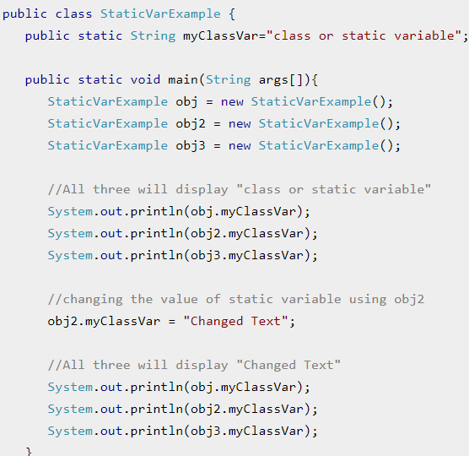
Static Variable
Static variables are also known as class variable because they are associated with the class and common for all the instances of class.
For example, If I create three objects of a class and access this static variable, it would be common for all, the changes made to the variable using one of the object would reflect when you access it through other objects.
Notes:
Output:
class or static variable
class or static variable
class or static variable
Changed Text
Changed Text
Changed Text
As you can see all three statements displayed the same output irrespective of the instance through which it is being accessed. That’s is why we can access the static variables without using the objects like this:

Slide 14
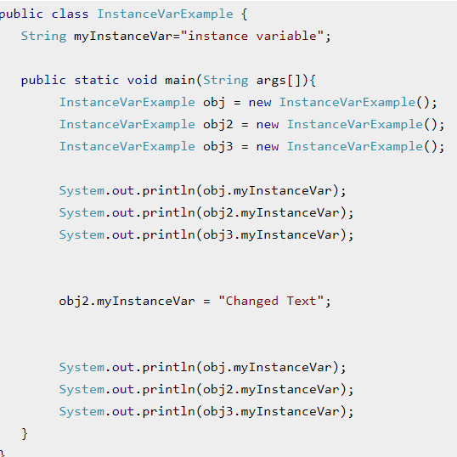
Instance Variable
Each instance(objects) of class has its own copy of instance variable.
Unlike static variable, instance variables have their own separate copy of instance variable.
We have changed the instance variable value using object obj2 in the following program and when we displayed the variable using all three objects, only the obj2 value got changed, others remain unchanged. This shows that they have their own copy of instance variable.
Notes:
Output:
instance variable
instance variable
instance variable
instance variable
Changed Text
instance variable

Slide 15
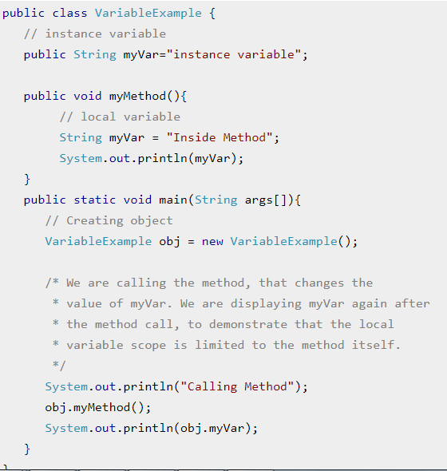
Local Variable
These variables are declared inside method of the class.
Their scope is limited to the method which means that You can’t change their values and access them outside of the method.
In this example, I have declared the instance variable with the same name as local variable, this is to demonstrate the scope of local variables.
Notes:
Output:
Calling Method
Inside Method
instance variable
If I hadn’t declared the instance variable and only declared the local variable inside method then the statement System.out.println(obj.myVar); would have thrown compilation error. As you cannot change and access local variables outside the method.

Slide 16
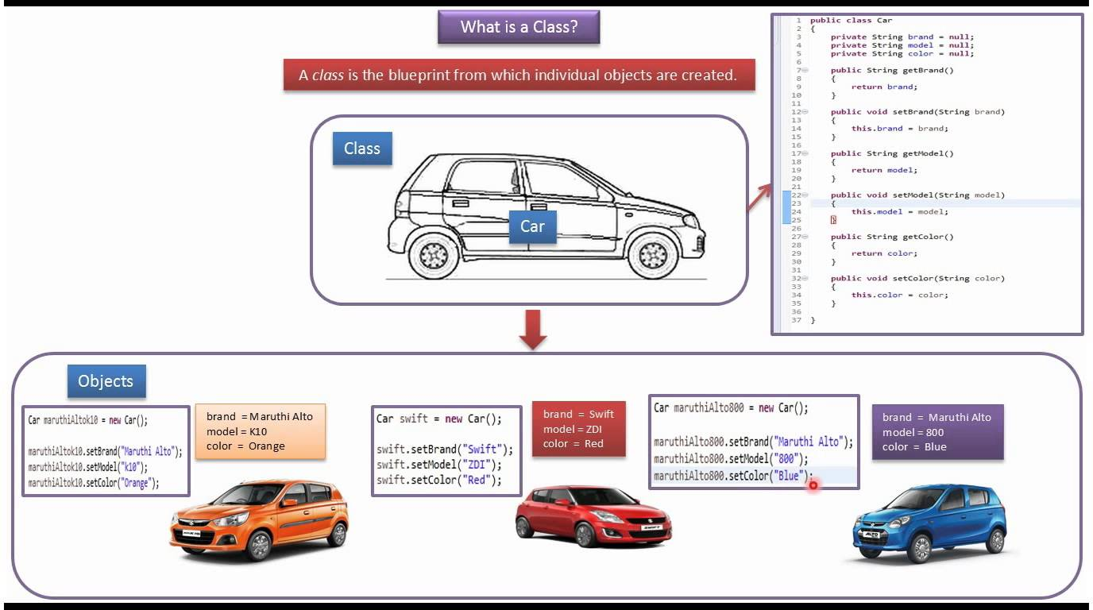
Classes
The class is at the core of Java.
It is the logical construct upon which the entire Java language is built because it defines the shape and nature of an object.
A class can also be considered as a user-defined data type.
Variables and Functions can be created within class
Any concept you wish to implement in a Java program must be encapsulated within a class.

Slide 17
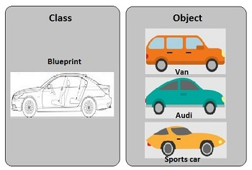
Objects
An object in JAVA is essentially a block of memory that contains space to store all the instance variables.
Creating an object also refers to INSTANTIATING AN OBJECT.
When you create a class, you are creating a new data type. You can use this type to create objects of that type.
However, obtaining objects of a class is a two-step process.
  First, you must declare a variable of the class type. This variable does not define an object. Instead, it is simply a variable that can refer to an object.
  Second, you must acquire an actual, physical copy of the object and assign it to that variable.
You can do this using the new operator. The new operator dynamically allocates (that is, allocates at run time) memory for an object and returns a reference to it. This reference is, more or less, the address in memory of the object allocated by new. This reference is then stored in the variable.
Thus, in Java, all class objects must be dynamically allocated. Let’s look at the details of this procedure.

Slide 18
Constructors
What is a Constructor
We have seen classes, and have seen objects. Let us step into Constructors
Constructor looks like a method but it is in fact not a method. It’s name is same as class name and it does not return any value. You must have seen this statement in almost all the programs I have shared above:
MyClass obj = new MyClass();
If you look at the right side of this statement, we are calling the default constructor of class myClass to create a new object (or instance).
We can also have parameters in the constructor, such constructors are known as parametrized constructors.

Slide 19
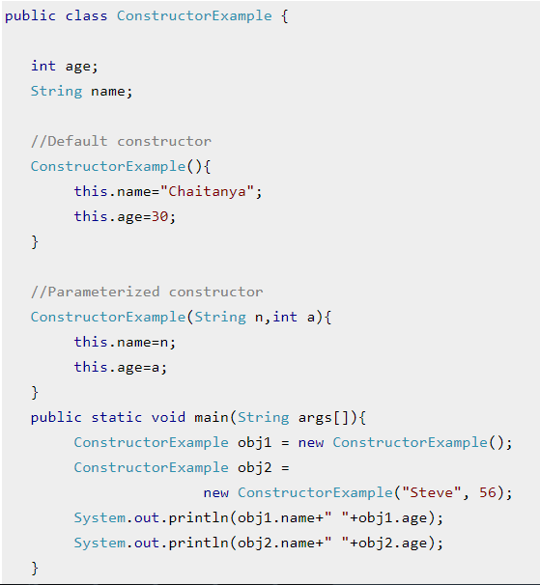
Constructors

Slide 20
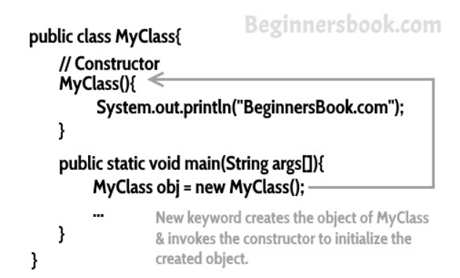
Constructors
Constructor is a block of code that initializes the newly created object.
A constructor resembles an instance method in java but it’s not a method as it doesn’t have a return type.
Constructor has same name as the class and looks like this in a java code.
public class MyClass{ //This is the constructor MyClass(){ } .. }
The new keyword here creates the object of class MyClass and invokes the constructor to initialize this newly created object.

Slide 21
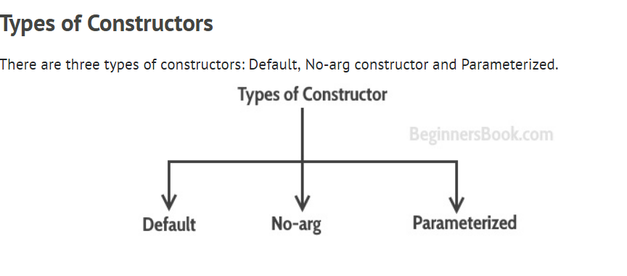
Constructors

Slide 22
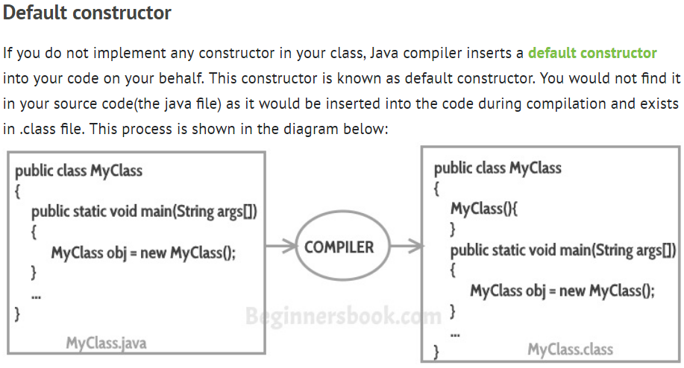
Constructors

Slide 23
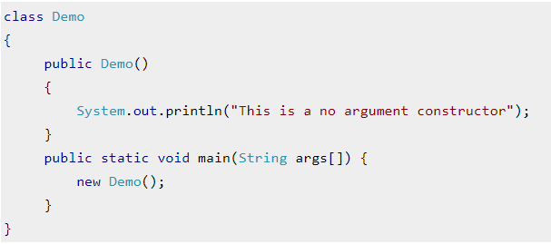
Constructors
No-Arg Constructors
Constructor with no arguments is known as no-arg constructor.
The signature is same as default constructor, however body can have any code unlike default constructor where the body of the constructor is empty.
Although you may see some people claim that that default and no-arg constructor is same but in fact they are not, even if you write public Demo() { } in your class Demo it cannot be called default constructor since you have written the code of it.

Slide 24
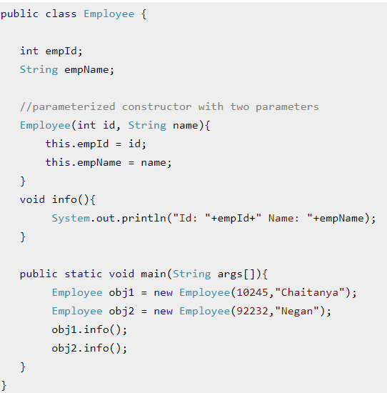
Constructors
Constructor with arguments(or you can say parameters) is known as Parameterized constructor.

Slide 25
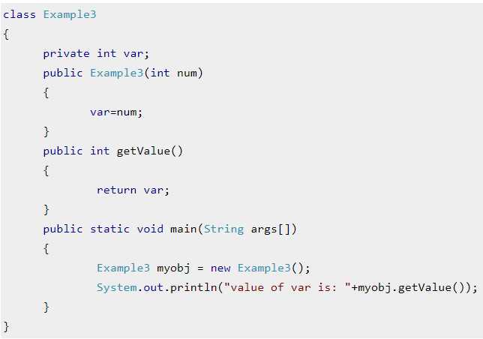
Guess what Happens
Study the code and write what will happen?
This can be resolved by adding a no-args constructor.
Note: By default JVM adds a no-args constructor, however if a parameterized one exists, then you should specify a no-args explicitly
Notes:
It will throw a compilation error. The reason is, the statement Example3 myobj = new Example3() is invoking a default constructor which we don’t have in our program. when you don’t implement any constructor in your class, compiler inserts the default constructor into your code, however when you implement any constructor (in above example I have implemented parameterized constructor with int parameter), then you don’t receive the default constructor by compiler into your code.

Slide 26
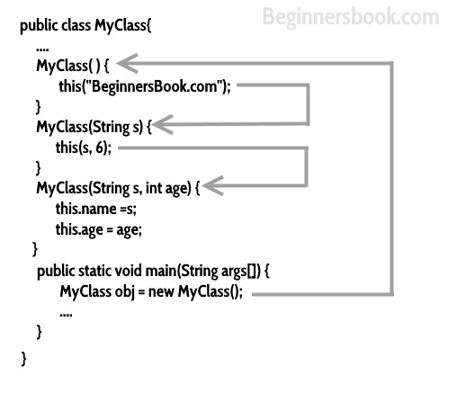
Constructors
Calling a constructor from the another constructor of same class is known as Constructor chaining.
The real purpose of Constructor Chaining is that you can pass parameters through a bunch of different constructors, but only have the initialization done in a single place.
This allows you to maintain your initializations from a single location, while providing multiple constructors to the user.
If we don’t chain, and two different constructors require a specific parameter, you will have to initialize that parameter twice, and when the initialization changes, you’ll have to change it in every constructor, instead of just the one.

Slide 27
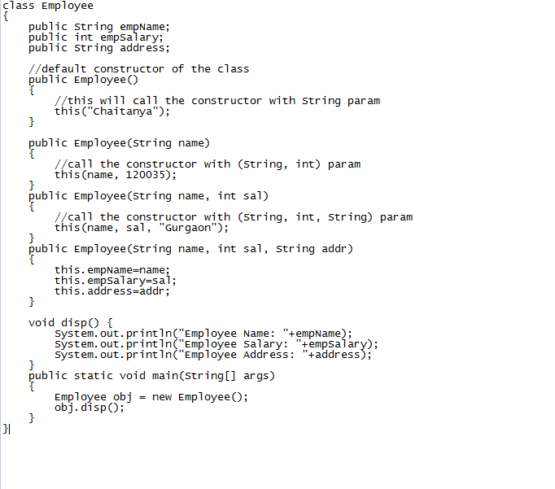
Constructors – Chaining Example
this() should always be the first statement in constructor otherwise you will get this error message: Exception in thread “main” java.lang.Error: Unresolved compilation problem: Constructor call must be the first statement in a constructor
Notes:
Employee Name: Chaitanya
Employee Salary: 120035
Employee Address: Gurgaon

Slide 28
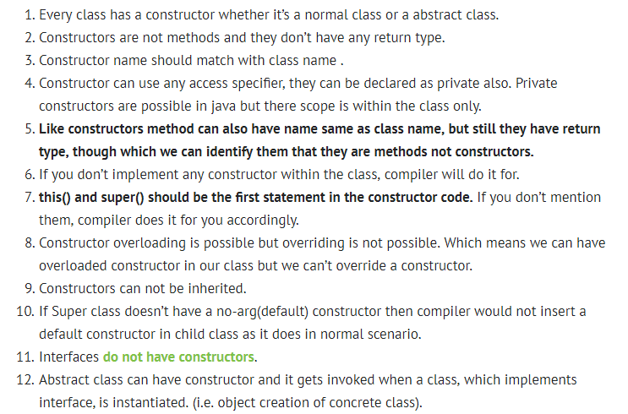
Constructors - Conclusion

Slide 29
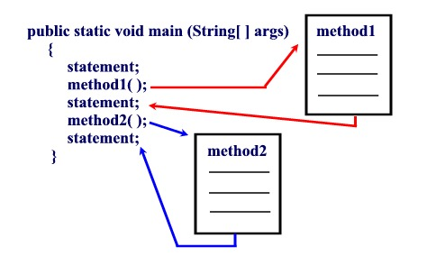
Methods
A method is a collection of statements that perform some specific task and return result to the caller.
A method can perform some specific task without returning anything.
Methods allow us to reuse the code without retyping the code.
In Java, every method must be part of some class
Each method has its own name. When that name is encountered in a program, the execution of the program branches to the body of that method.
When the method is finished, execution returns to the area of the program code from which it was called, and the program continues on to the next line of code.

Slide 30
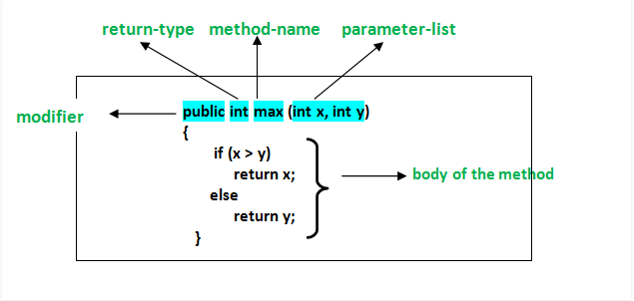
Methods Structure
Modifier-: Defines access type of the method i.e. from where it can be accessed in your application. In Java, there 4 type of the access specifiers.
  public: accessible in all class in your application.
  protected: accessible within the class in which it is defined and in its subclass(es)
  private: accessible only within the class in which it is defined.
  default (declared/defined without using any modifier) : accessible within same class and package within which its class is defined.
The return type : The data type of the value returned by the method or void if does not return a value.
Method Name : the rules for field names apply to method names as well, but the convention is a little different.
Parameter list : Comma separated list of the input parameters are defined, preceded with their data type, within the enclosed parenthesis. If there are no parameters, you must use empty parentheses ().
Exception list : The exceptions you expect by the method can throw, you can specify these exception(s).
Method body : it is enclosed between braces. The code you need to be executed to perform your intended operations.

Slide 31
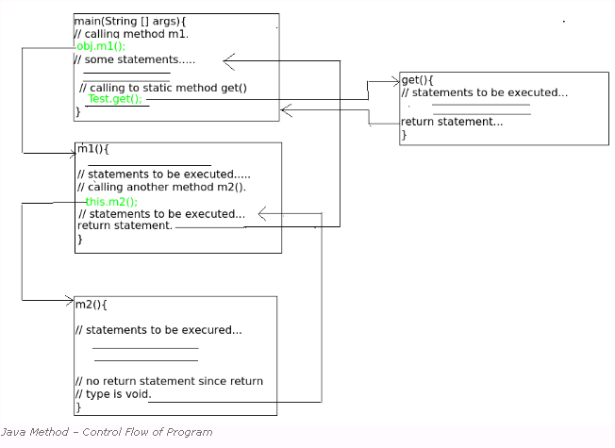
Methods

Slide 32
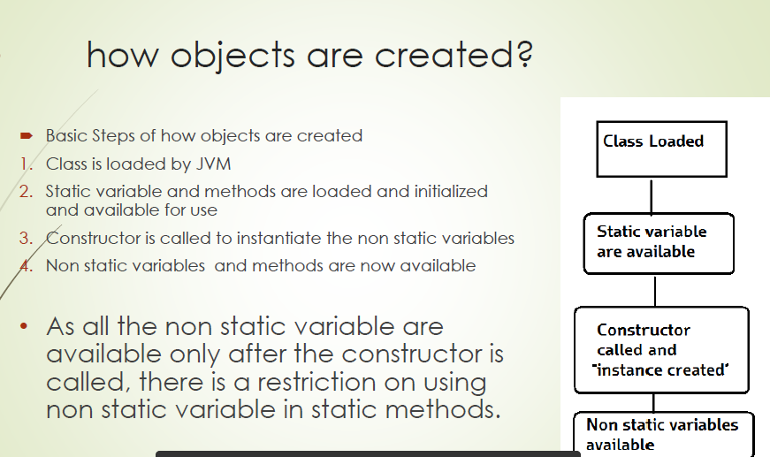
Static Methods

Slide 33
Static Methods
A static method is invoked on behalf of an entire class, not on a specific object instantiated from that class.
Such methods are also known as class methods. A static method might perform a general task for all objects of the class, such as returning the next available serial number or something of that nature.
A static method can access only static fields and other static methods of the class. This is because non-static members must be accessed through an object reference, and no object reference is available within a static method
A static method can be invoked without the need for creating an instance of a class.
static method can access static data member and can change the value of it.

Slide 34
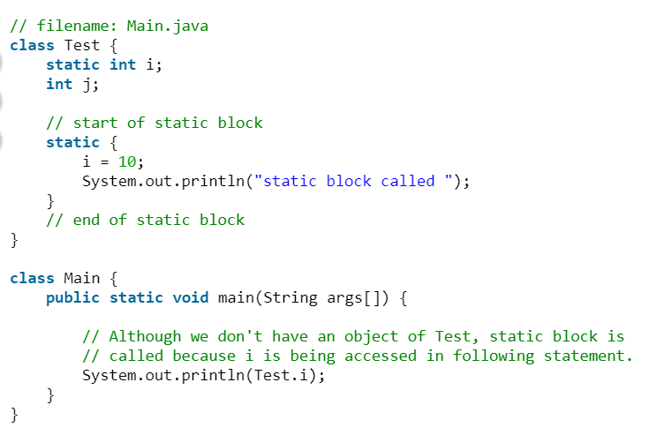
Static Blocks
Unlike C++, Java supports a special block, called static block (also called static clause) which can be used for static initializations of a class.
This code inside static block is executed only once: the first time you make an object of that class or the first time you access a static member of that class (even if you never make an object of that class).
For example, check output of following Java program.

Slide 35
Methods - Invocation
Each method is declared to have a specific number of parameters, each of a specific type. The last parameter of a method can be declared as a sequence of parameters of a given type.
This is indicated by an ellipse (...) after the type name. For example, String... is a sequence of zero or more String objects.
Sequence parameters allow you to invoke the method by passing in a variable number of arguments, some of which will correspond to that sequence.
When a method is invoked the caller must provide an argument of the appropriate type for each of the parameters declared by the method.
An argument need not be exactly the same type as its corresponding parameter because some automatic conversions are applied. For example, a byte argument can be converted to an int parameter, and wrapper objects can be converted to their primitive values (and vice-versa) as needed.
Methods also have a return type, either a primitive type or a reference type. If a method does not return any value, the place where a return type would go is filled with a void.
Notes:
By default when we say methods it means non static

Slide 36
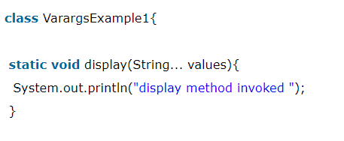
Methods – Variable number of arguments
Formal Parameters: The variables declared inside the braces following the method name.
The last parameter in a method (or constructor) parameter list can be declared as a sequence of a given type.
To indicate that a parameter is a sequence you write an ellipse (...) after the parameter type, but before its name.
the parameter messages is declared to be a sequence of String objects. Sequence parameters allow a method to be invoked with a variable number of arguments (including zero) that form the sequence.
Such methods are known as variable-argument, or more commonly varargs methods; methods that don't declare a sequence parameter are known as fixed-argument methods.
More formally, the number of arguments that can be passed to a method invocation is known as the arity of the invocation. Varargs methods are variable-arity methods, while fixed-argument methods are fixed-arity methods.
Notes:
By default when we say methods it means non static

Slide 37
Methods – Invocation
When a method is invoked, the flow of control passes from the calling method into the invoked method and the statements of that method are executed in sequence according to the semantics of those statements.
A method completes execution and returns to the caller when one of three things happens: a return statement is executed, the end of the method is reached, or an uncaught exception is thrown.
If a method returns any result, it can only return a single result either a primitive value or a reference to an object.
Methods that need to return more than one result can achieve this effect in several ways: return references to objects that store the results as fields, take one or more parameters that reference objects in which to store the results, or return an array that contains the results.
Notes:
By default when we say methods it means non static

Slide 38
This , That What ??
Keyword THIS is a reference variable in Java that refers to the current object. The various usages of 'THIS' keyword in Java are as follows:
  It can be used to refer instance variable of current class
  It can be used to invoke or initiate current class constructor
  It can be passed as an argument in the method call
  It can be passed as argument in the constructor call
  It can be used to return the current class instance
The main purpose of using this keyword is to differentiate the formal parameter and data members of class, whenever the formal parameter and data members of the class are similar then jvm get ambiguity (no clarity between formal parameter and member of the class)
To differentiate between formal parameter and data member of the class, the data member of the class must be preceded by "this".
"this" keyword can be use in two ways.
this . (this dot)
this() (this off)
Notes:
By default when we say methods it means non static

Slide 39
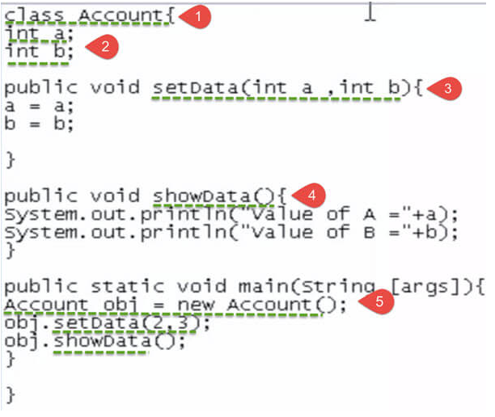
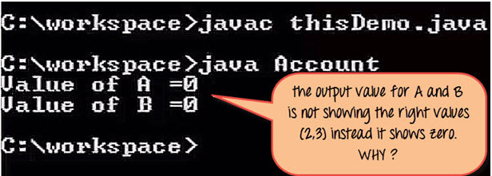
This , That What ?? – What happened here?
Source Code
Output
Notes:
By default when we say methods it means non static

Slide 40
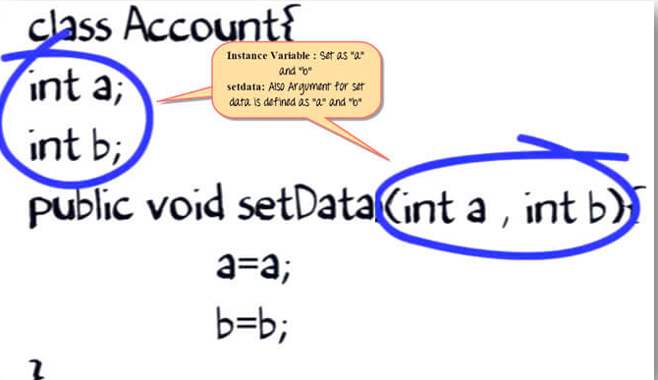
This , That What ?? – What happened here?
1. In the method Set data, the arguments are declared as a and b, while the instance variables are also named as a and b.
Notes:
By default when we say methods it means non static

Slide 41
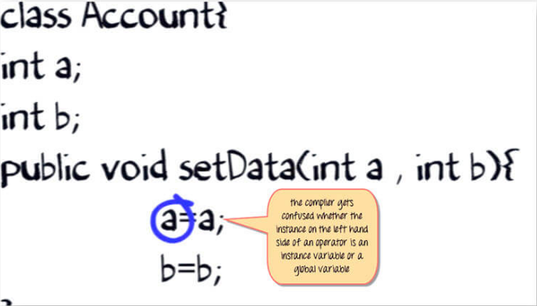
This , That What ?? – What happened here?
2. During execution, the compiler is confused. Whether "a" on the left side of the assigned operator is the instance variable or the local variable. Hence, it does not set the value of 'a' when the method set data is called.
Notes:
By default when we say methods it means non static

Slide 42
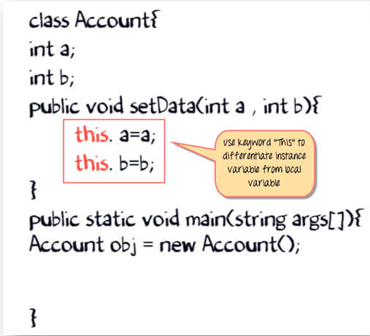
This , That What ?? – What happened here?
3. The solution is the "THIS" keyword Append both 'a' and 'b' with the "this" keyword followed by a dot (.) operator.
Notes:
By default when we say methods it means non static

Slide 43
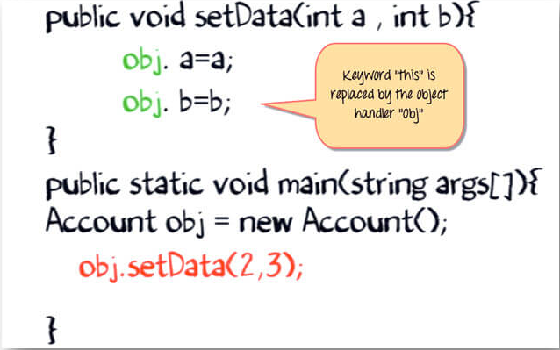
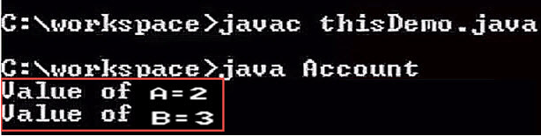
This , That What ?? – What happened here?
4. During code execution when an object calls the method 'setdata'. The keyword 'this' is replaced by the object handler "obj." So now the compiler knows, The 'a' on the left-hand side is an Instance variable. Whereas the 'a' on right-hand side is a local variable The variables are initialized correctly, and the expected output is shown.
Notes:
By default when we say methods it means non static

Slide 44
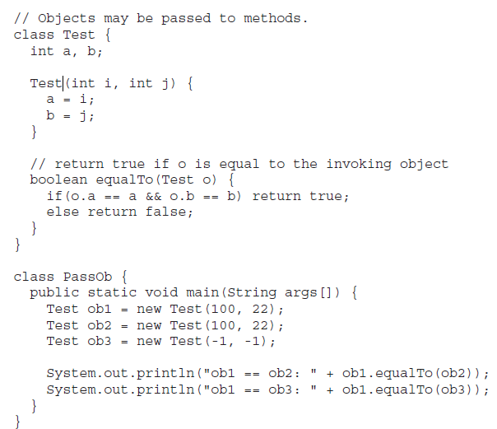
Passing Objects as Argument
Java does manipulate objects by reference, and all object variables are references. However, Java doesn't pass method arguments by reference; it passes them by value.
So far, we have only been using simple types as parameters to methods. However, it is both correct and common to pass objects to methods. For example, consider the following short program:
Notes:
By default when we say methods it means non static

Slide 45
Passing Objects as Argument
In general, there are two ways that a computer language can pass an argument to a subroutine.
The first way is call-by-value.
  This approach copies the value of an argument into the formal parameter of the subroutine.
  Therefore, changes made to the parameter of the subroutine have no effect on the argument.
The second way an argument can be passed is call-by-reference.
  In this approach, a reference to an argument (not the value of the argument) is passed to the parameter.
  Inside the subroutine, this reference is used to access the actual argument specified in the call.
  This means that changes made to the parameter will affect the argument used to call the subroutine.
As you will see, although Java uses call-by-value to pass all arguments, the precise effect differs between whether a primitive type or a reference type is passed.
Notes:
By default when we say methods it means non static

Slide 46
Passing Objects as Argument
When you pass a primitive type to a method, it is passed by value. Thus, a copy of the argument is made, and what occurs to the parameter that receives the argument has no effect outside the method
// Primitive types are passed by value.
class Test {
void meth(int i, int j) {
i *= 2;
j /= 2;
}
}
class CallByValue {
public static void main(String args[]) {
Test ob = new Test();
int a = 15, b = 20;
System.out.println("a and b before call: " + a + " " + b);
ob.meth(a, b);
System.out.println("a and b after call: " + a + " " + b);
}
}
Notes:
By default when we say methods it means non static

Slide 47
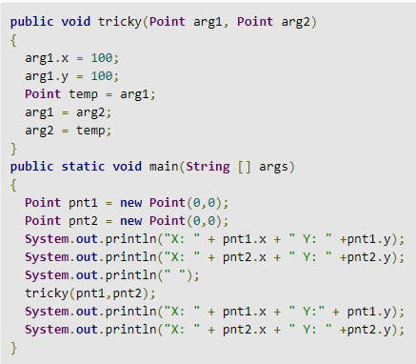
Passing Objects as Argument
When you pass an object to a method, the situation changes dramatically, because objects are passed by what is effectively call-by-reference. Keep in mind that when you create a variable of a class type, you are only creating a reference to an object. Thus, when you pass this reference to a method, the parameter that receives it will refer to the same object as that referred to by the argument. This effectively means that objects act as if they are passed to methods by use of call-by-reference. Changes to the object inside the method do affect the object used as an argument.
Notes:
By default when we say methods it means non static

Slide 48
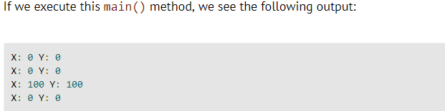
Passing Objects as Argument
 | REMEMBER When an object reference is passed to a method, the reference itself is passed by use of call-by-value. However, since the value being passed refers to an object, the copy of that value will still refer to the same object that its corresponding argument does.
Notes:
By default when we say methods it means non static

Slide 49
Method Overloading
In Java, it is possible to define two or more methods within the same class that share the same name, as long as their parameter declarations are different.
When this is the case, the methods are said to be overloaded, and the process is referred to as method overloading.
Method overloading is one of the ways that Java supports polymorphism.
When an overloaded method is invoked, Java uses the type and/or number of arguments as its guide to determine which version of the overloaded method to actually call.
Thus, overloaded methods must differ in the type and/or number of their parameters.
While overloaded methods may have different return types, the return type alone is insufficient to distinguish two versions of a method.
When Java encounters a call to an overloaded method, it simply executes the version of the method whose parameters match the arguments used in the call. Java will employ its automatic type conversions only if no exact match is found.
Notes:
By default when we say methods it means non static

Slide 50

Questions ?
You can contact me @
avadekkedhil@wilp.bits-pilani.ac.in
9881300394

